Slide 1




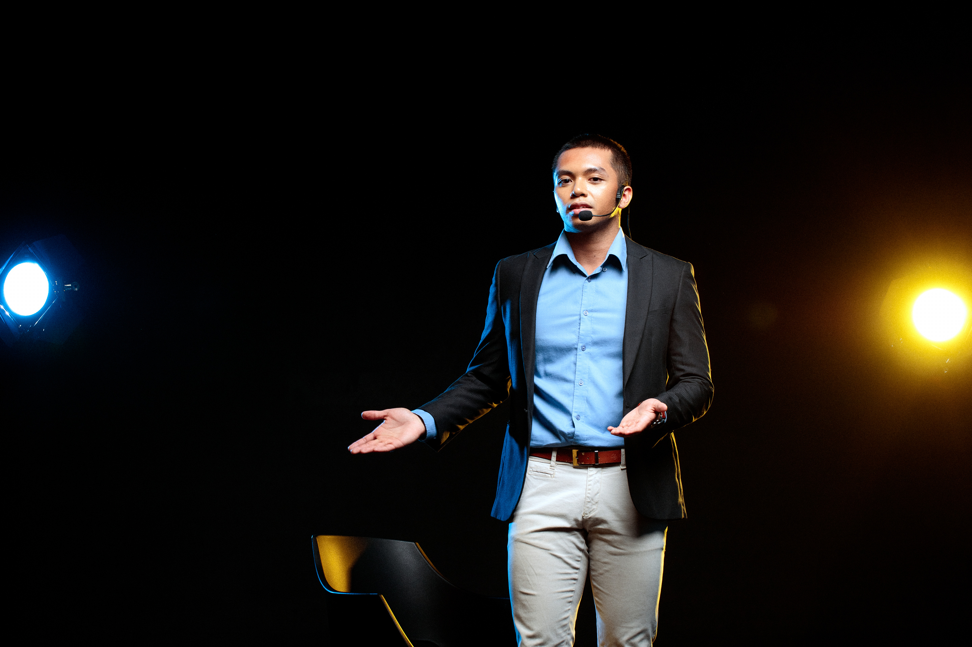

2024
Enique
CAPSTONE I
StonkGo
Harnessing Sentiments for Bitcoin Investment Strategy
Anna Han Mu Mio Esther Xu
2024-03-28

Slide 2

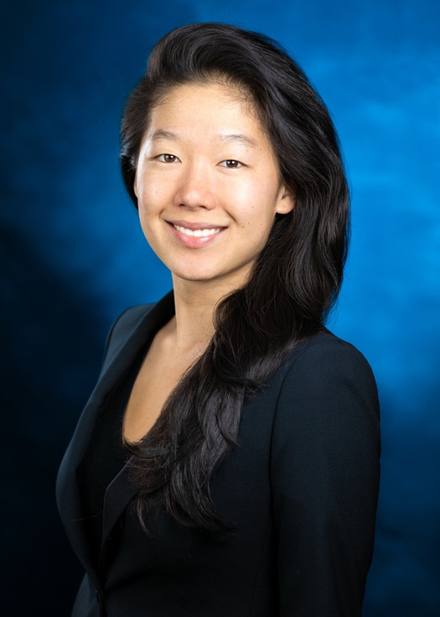


Our Team
ANNA HAN
MU MIO
ESTHER XU
ahan92@uchicago.edu
airc@uchicago.edu
estherxu@uchicago.edu

Slide 3

Agenda
01
Overview
04
Future State Scenarios
02
As-Is Scenario Map
05
Project Scope
03
Identification of Big Ideas

Slide 4
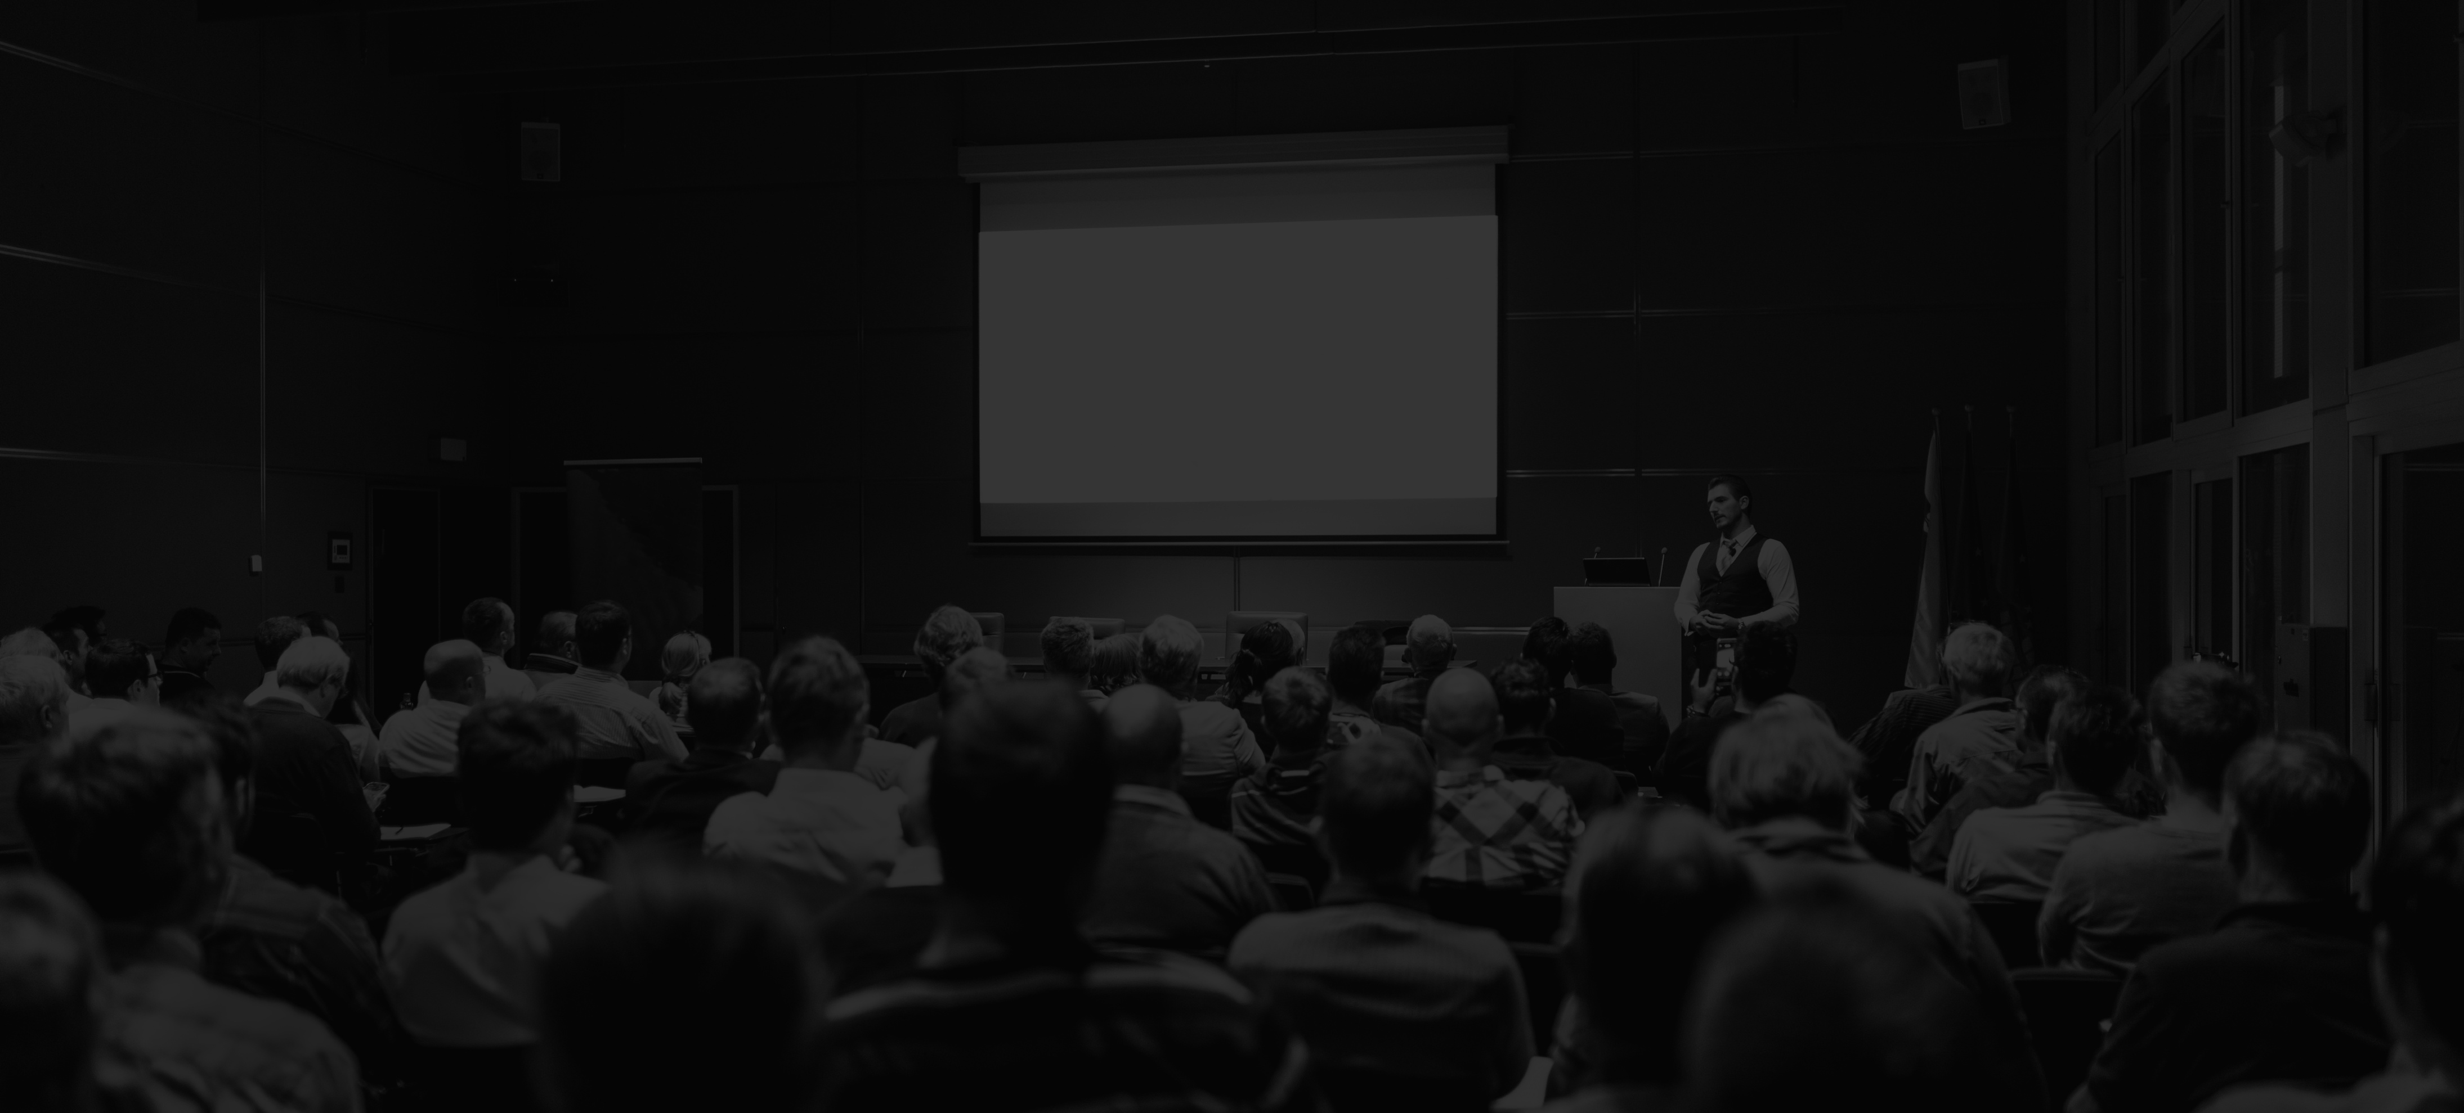


OVERVIEW
Retail investors lack effective guidance on how to make short-term profits from Bitcoin relative to traditional investment assets.
Bitcoin Financial Advisor services said need by extracting prediction signals from Reddit data and customizing recommendations to investors’ dynamic needs.

Slide 5

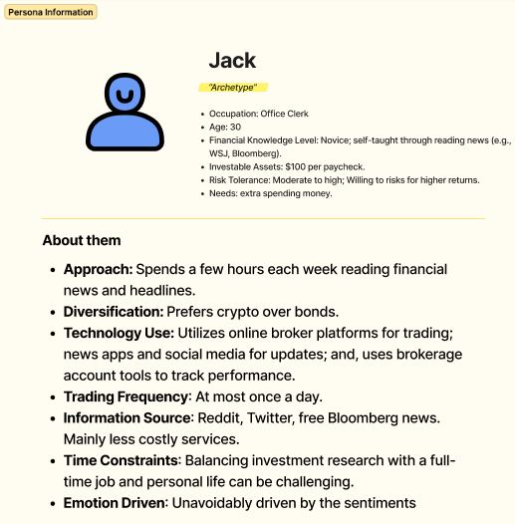
PERSONA: JACK

Slide 6



AS-IS Scenario Map
Know Your Customer
Initiate Trade
Manage Position
Exit Position
Allocating $$ to invest.
Set primary target return and time frame.
Choose time frame.
Buy/sell bitcoin to open a position.
Actively track investment performance / bitcoin price.
Update position – increase or decrease position based on performance so far and predicted outlook.
Update risk tolerance and goals.
Close position and take home PnL.
Spend earnings.
Miss out on activity due to losses/lack of profits.
DOING
What is my PnL vs. investment horizon elasticity?
I’m planning a trip next month so I need to earn more but my window is longer.
I just need a little extra spending money for this weekend.
What level of positive return would satisfy me enough to close my trade early?
What magnitude of loss would force me to capitulate?
E.g., If I lose 50% of my initial investment, I’m cutting my losses.
The chance I achieve my investment goals are high enough for me to take action.
I better be disciplined and cut my losses if I hit my loss limit.
If I make my return goal much quicker than expected, maybe there’s momentum and I should increase my position.
Should I increase or decrease position?
How does the performance so far change my confidence?
How does the performance so far and probabilities of expected performance impact my decision?
Has my time window changed?
How can I get more profit?
Why did I lose again?
THINKING
Lucky like it’ll work out.
Anxious about losing money.
Uncertain if risk appetitive is correct.
YOLO.
The jitters of having skin in the game.
Self-doubt if it’s the right move to make.
FOMO.
Stressful
Second guessing yourself when you are seeing losses.
Cocky – It’s going well I knew this was right idea I’ll increase my position
Cautious – I hit my goal early should I close it out now?
Positive PnL - excitement, satisfaction.
Negative PnL - regret, anger, frustration.
FEELING

Slide 7

PRIORITIZATION
OF
BIG IDEAS
100% Accuracy
Overriding user risk tolerance when user decisions (in hindsight) lead to worse performance.
HIGH
Real-time Sentiment Analysis from Reddit
Alert user of abrupt changes in predictions -- negative or positive.
Simulation of Investment Outcomes
Bitcoin price manipulation
Personalized Investment Recommendations dynamic to user changes in risk profile.
IMPORTANT TO USER
Identify trustworthy subreddit users to follow
Event-driven tuning of portfolio performance.
Visual Meme and Humor Analysis
Global Cryptocurrency News Aggregator
Integration with Cryptocurrency Wallets
Mix various data sources. Different sources cannot be weighed against each other as easily.
LOW
Educational Content on Crypto Investing
Offline Mode with Cached Data
DIFFICULT
FEASIBILITY FOR US
EASY

Slide 8


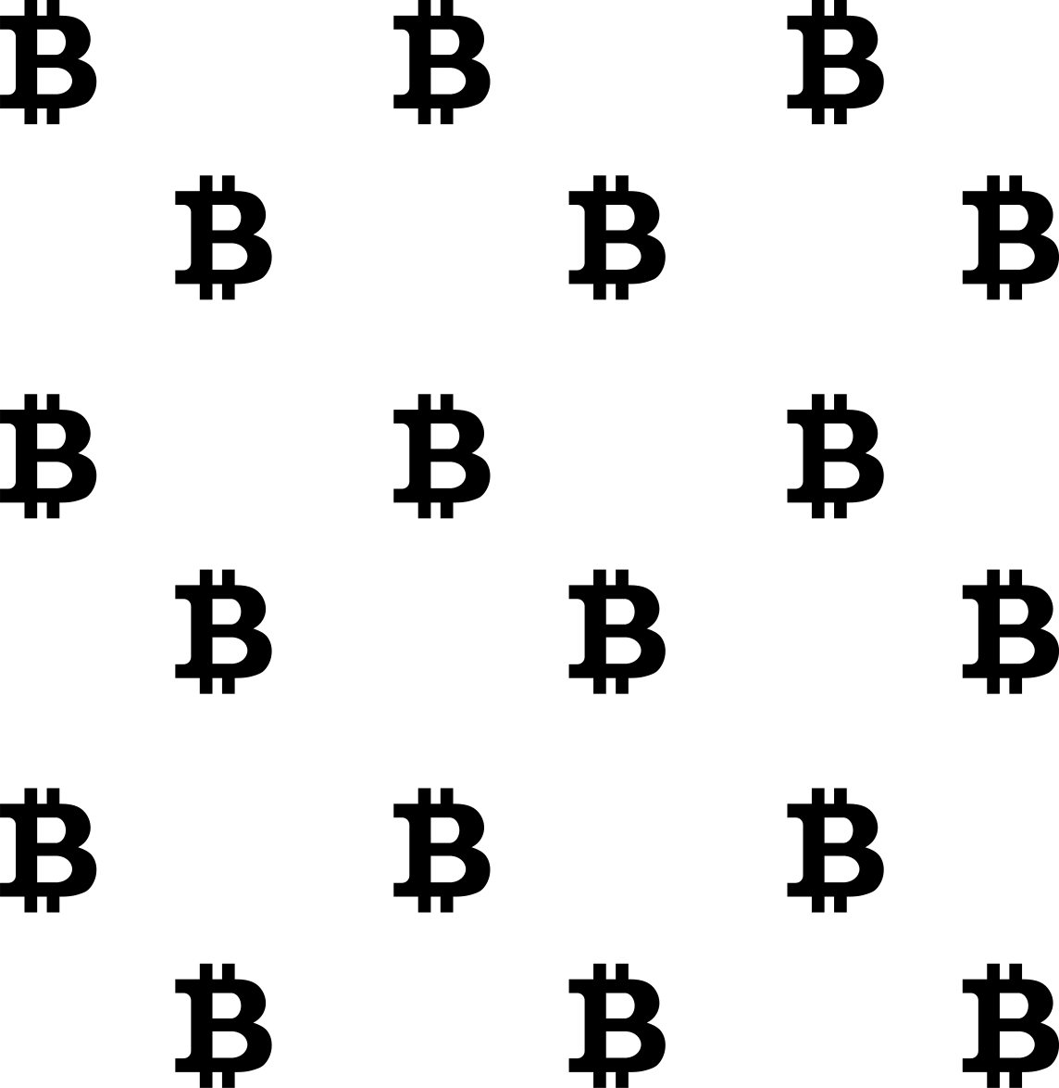

FUTURE STATE SCENARIOS
NEAR-TERM
1
Real-time sentiment analysis of subreddit specific to Bitcoin value.
Basic portfolio performance tracking.
Translate sentiment into likelihood of range of returns for various time windows. At this stage, user must decide for themselves which option.
Data digestion automation picks up new information regularly.
2
MID-TERM
Personalized advice. Based on past performance and user risk, can suggest which time holding frame and risk limits are best.
Enhance ML Algo with finer tuned sentiment scores.
Actively notifies user when to buy, sell, hold bitcoin.
Enhanced user interface with indicators and charts based on model’s heaviest features.
3
LONG-TERM
Stage 7
Analyze sentiment from more resources.
Provide advice for different cryptocurrencies or asset class.
Behavioral Insights.

Slide 9

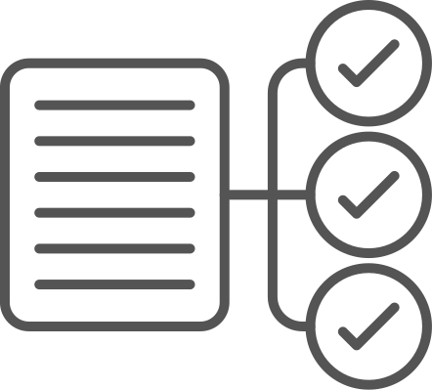



StonkGo will serve as a financial assistant tool that analyzes sentiment data from Reddit to provide personalized Bitcoin rationales. It will utilize natural language processing and machine learning to translate sentiment into predictive indicators for Bitcoin price movements, offering users signals to buy, sell, or hold Bitcoin.
Product Scope
Sentiment Analysis Model: A robust model that processes sentiment data from Reddit.
Price Predictive Models: Powered by machine learning, the model provides price targets
Conversational AI: An interactive application providing personalized, data-driven explanations.
User Dashboard: A real-time dashboard displaying sentiment indices, prediction confidence, and portfolio performance.
Documentation: Detailed documentation covering the model development, user manual, and project findings.
2020
Deliverables
Deliverables
Accuracy: The sentiment analysis model must achieve a benchmark accuracy rate (to be determined after initial testing) in predicting price trends.
Usability: The platform should be user-friendly, with a clear interface and dashboard, and accessible on both desktop and mobile devices.
Performance: The system should provide real-time alerts with a latency of no more than a few minutes from sentiment detection to notification.
Validation: The final product must pass a beta testing phase with a select group of users and meet their expectations for investment advice quality.
PROJECT
SCOPE
2019
Acceptance Criteria
2018
Provide financial, legal or tax advice
Engage in actual trading or hold funds for users
Analysis of other cryptocurrencies, stocks or bonds
Out of Scope
Volatile nature of Bitcoin which could impact model performances
Potential changes in Reddit's API or data policy that could affect data scraping activities.
Due to computational constraints, real-time data processing requirements may limit the complexity of the machine learning model.
The project assumes a continued high interest and discussion around Bitcoin on Reddit.
Risks
Constraints
Assumptions

Slide 10

2024
Enique
CAPSTONE I
Thank You For Attending

